Slide 1
NiChart

Slide 2
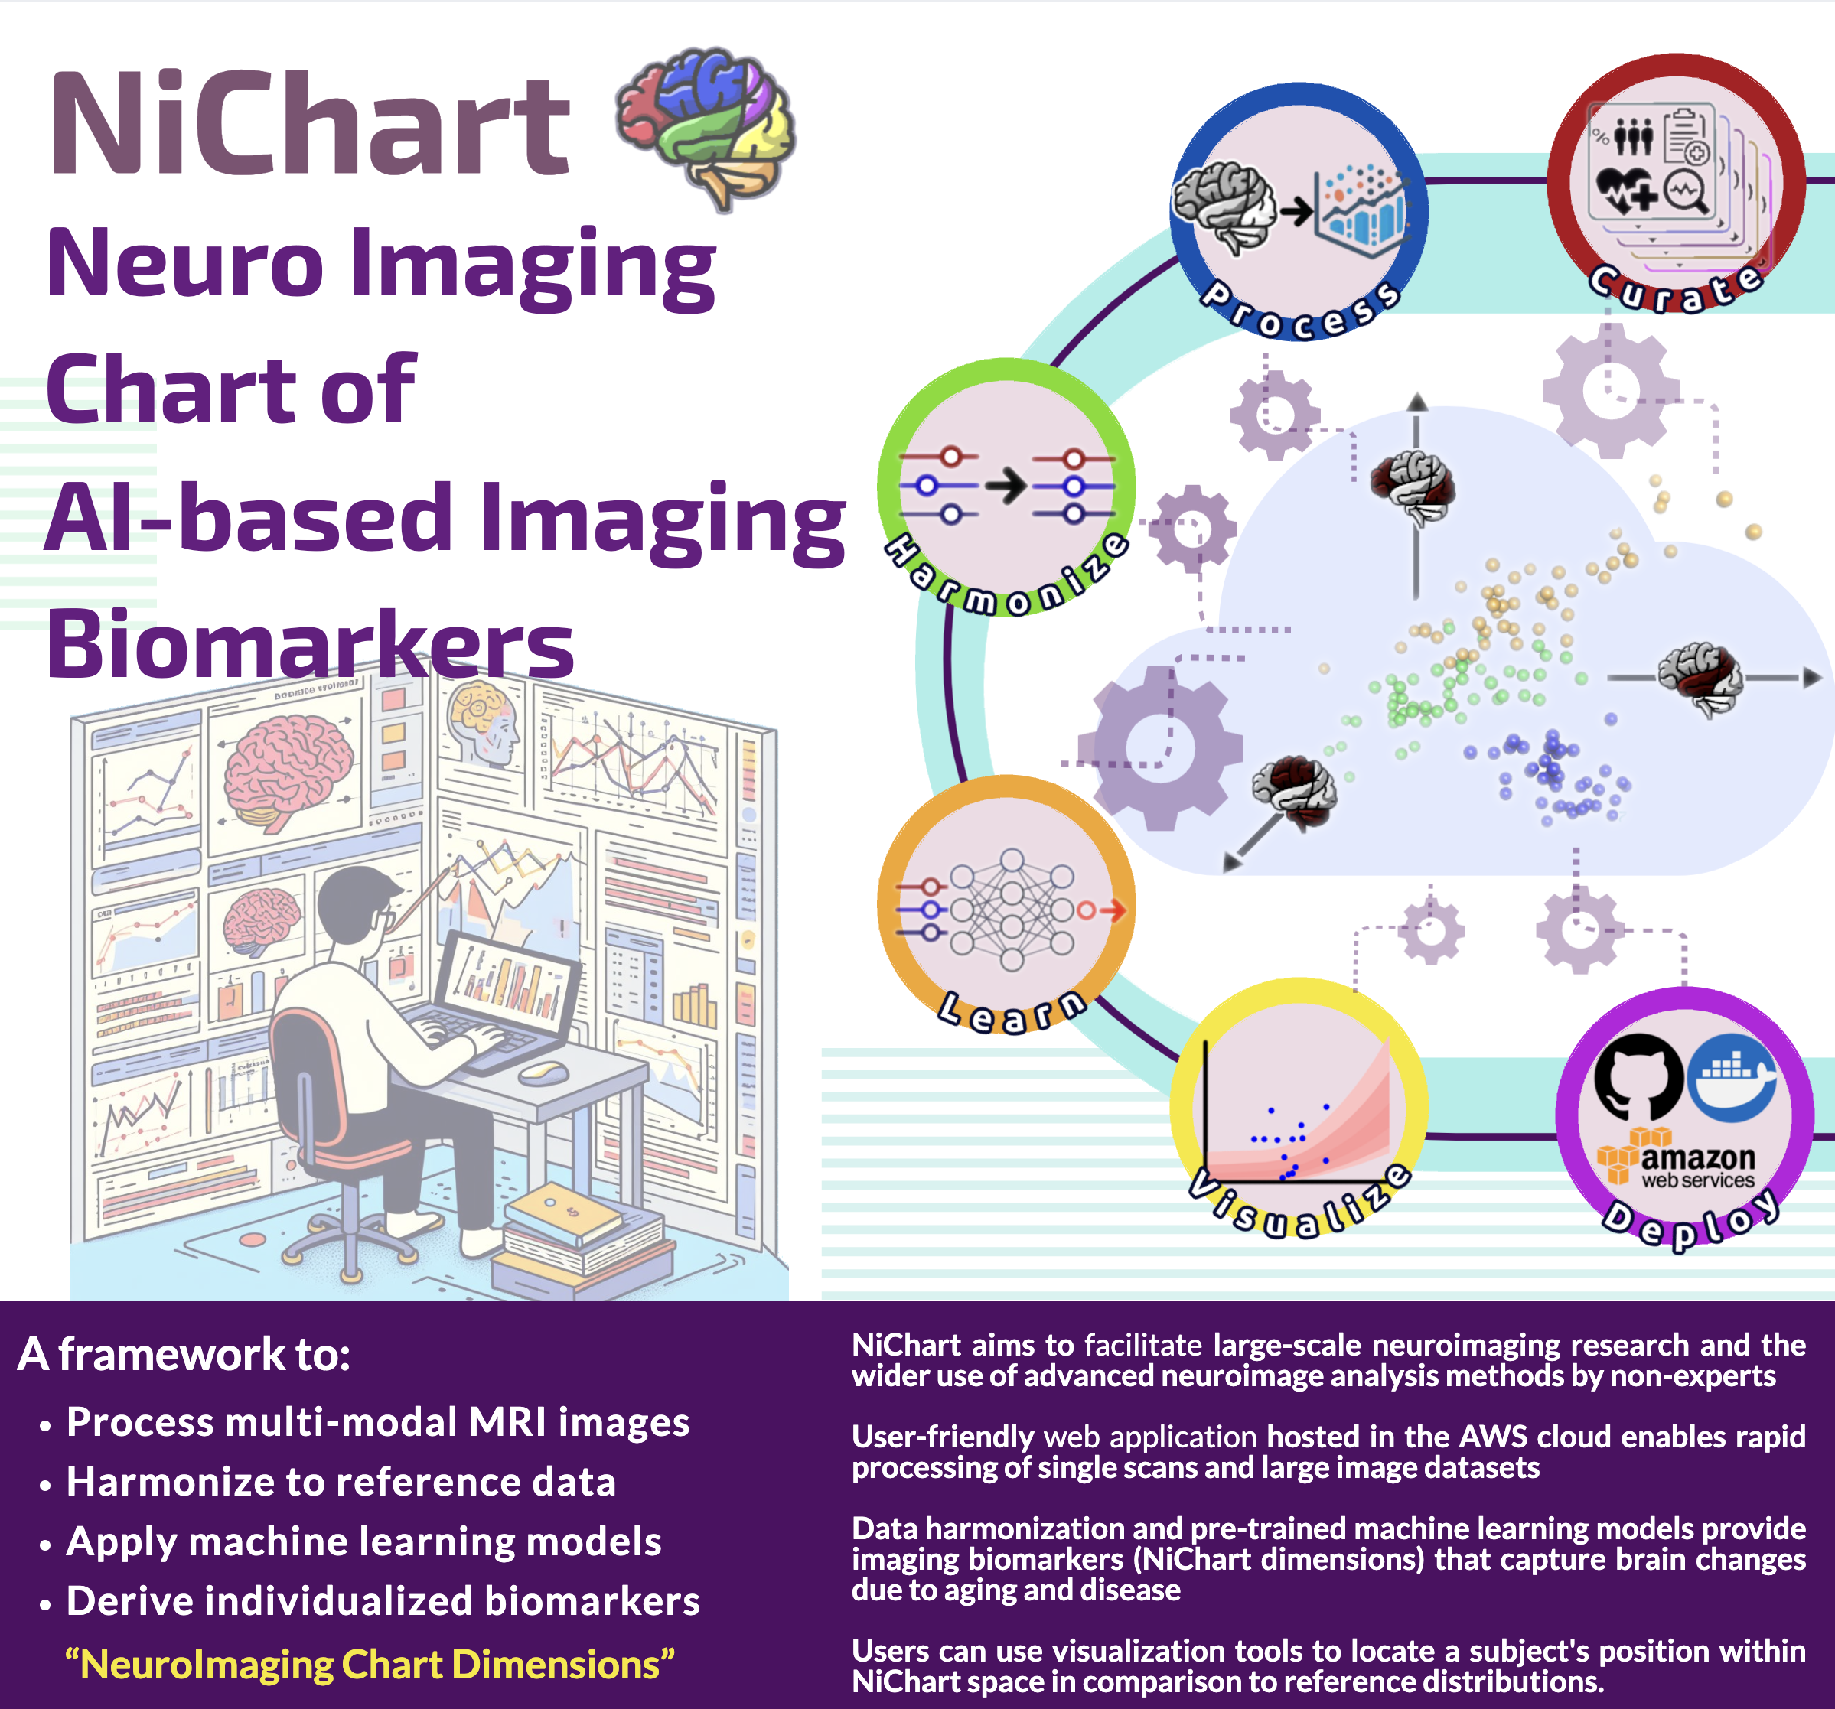
NiChart Overview
NiChart is a framework to:
﻿﻿Process multi-modal MRI images
﻿﻿Harmonize to reference data
﻿﻿Apply machine learning models
﻿﻿Derive individualized biomarkers
NiChart aims to:
Facilitate large-scale neuroimaging research
Enable rapid processing of single scans and large image datasets through a user-friendly web application
Harmonize data and apply pre-trained machine learning models
Provide imaging biomarkers that capture brain changes due to aging and disease
Provide visualization tools to locate a subject's position within NiChart space in comparison to reference distributions.
Notes:
NiChart is a computational framework designed to process multi-modal MRI data, harmonize it with reference datasets, and apply machine learning algorithms to extract individualized imaging biomarkers. These biomarkers are instrumental in quantifying brain changes due to aging and disease.
The framework is tailored to support large-scale neuroimaging studies, facilitating the use of advanced analytical methods by researchers. NiChart's capabilities include data harmonization, utilization of pre-trained models, and visualization tools for comparative analysis, all integral to neuroscientific research.

Slide 3
Notes:
NiChart is a computational framework designed to process multi-modal MRI data, harmonize it with reference datasets, and apply machine learning algorithms to extract individualized imaging biomarkers. These biomarkers are instrumental in quantifying brain changes due to aging and disease.
The framework is tailored to support large-scale neuroimaging studies, facilitating the use of advanced analytical methods by researchers. NiChart's capabilities include data harmonization, utilization of pre-trained models, and visualization tools for comparative analysis, all integral to neuroscientific research.

Slide 4
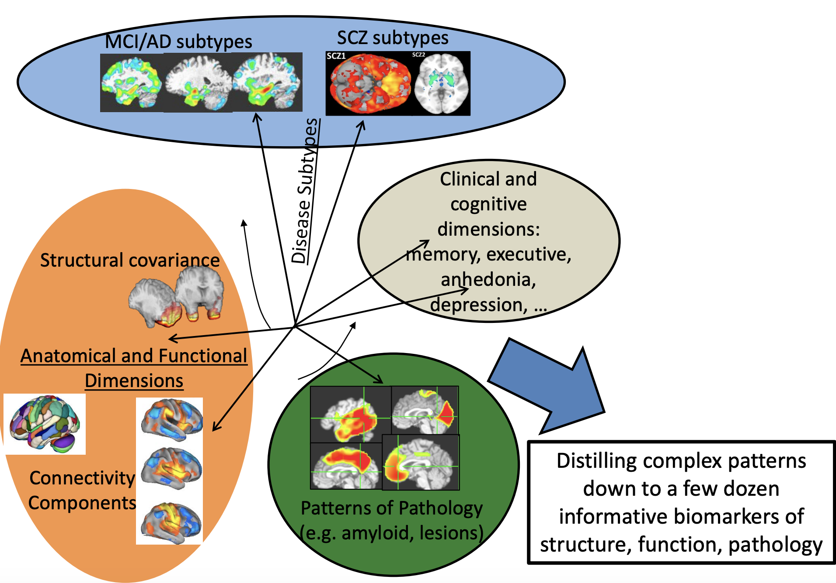
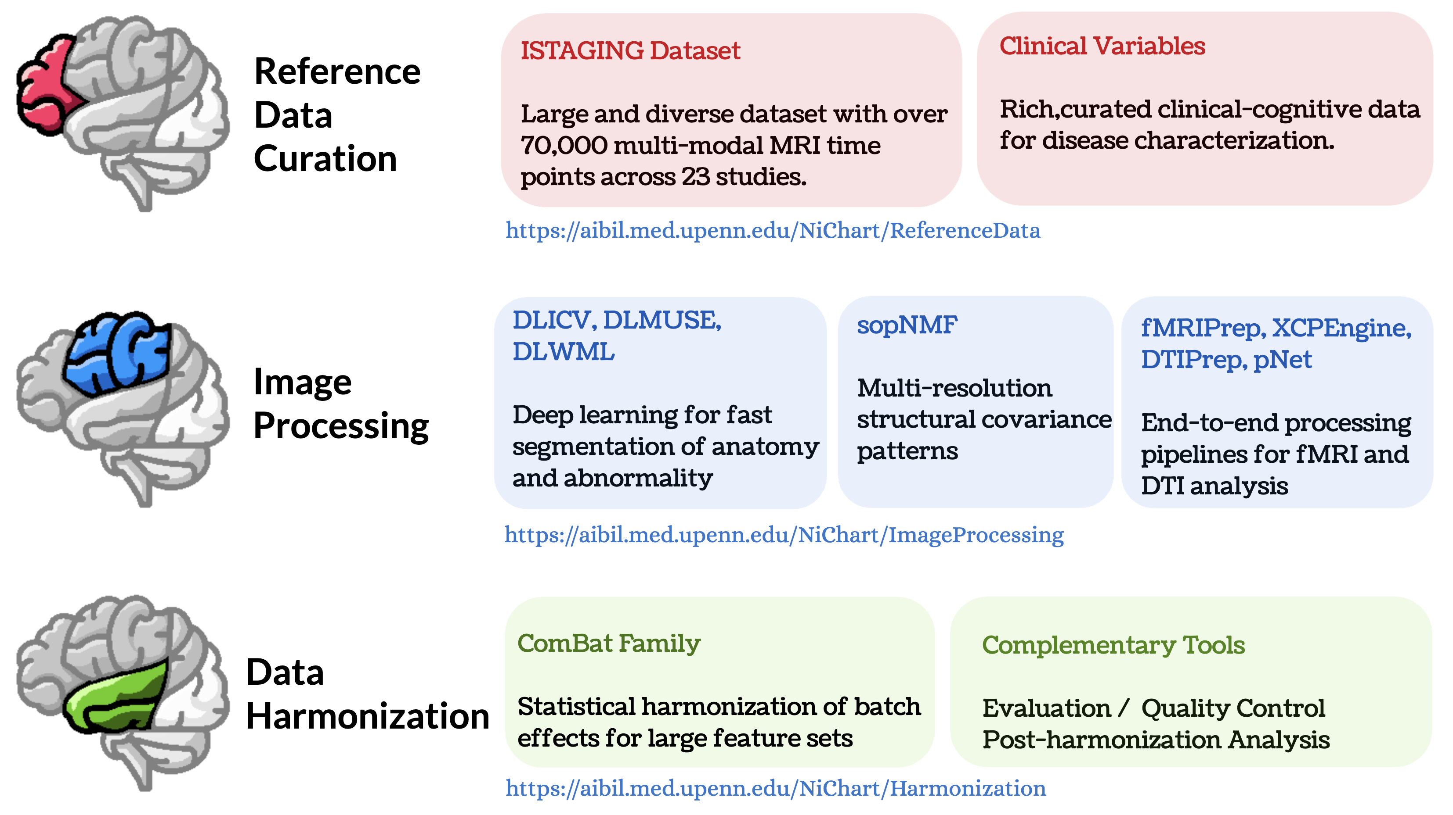
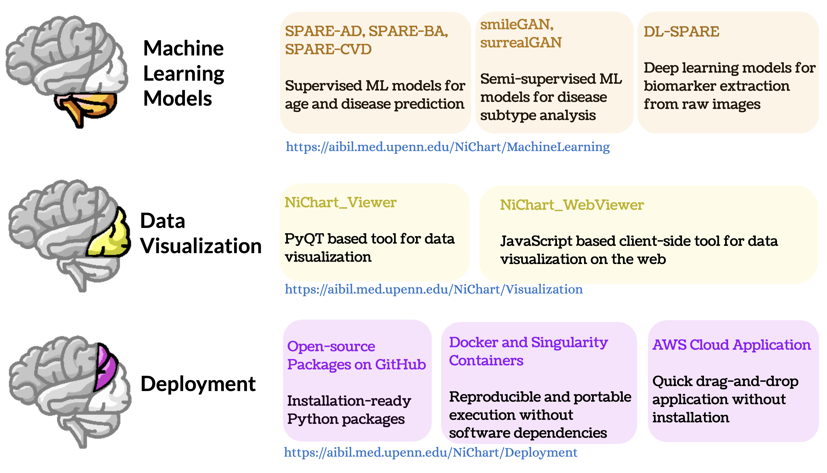
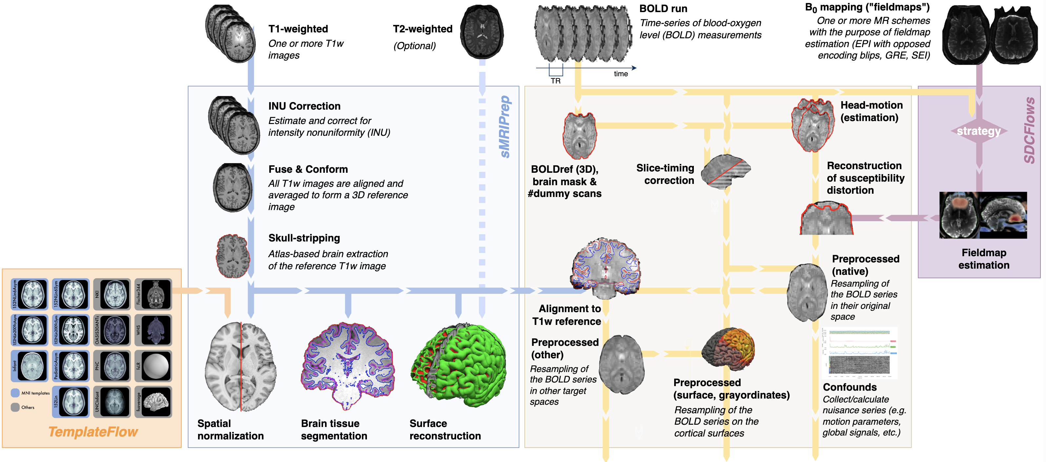
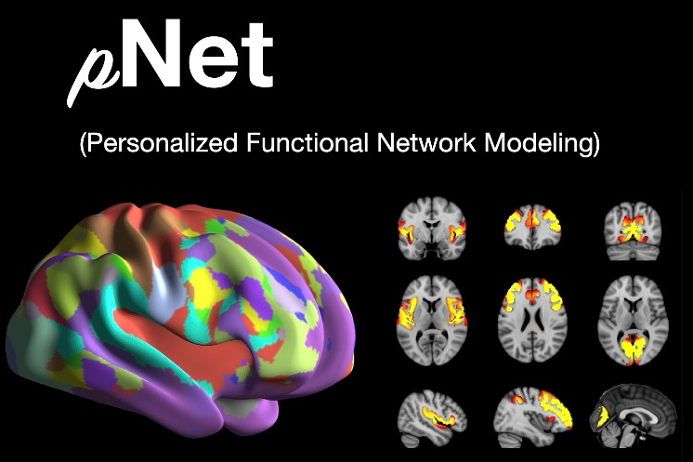
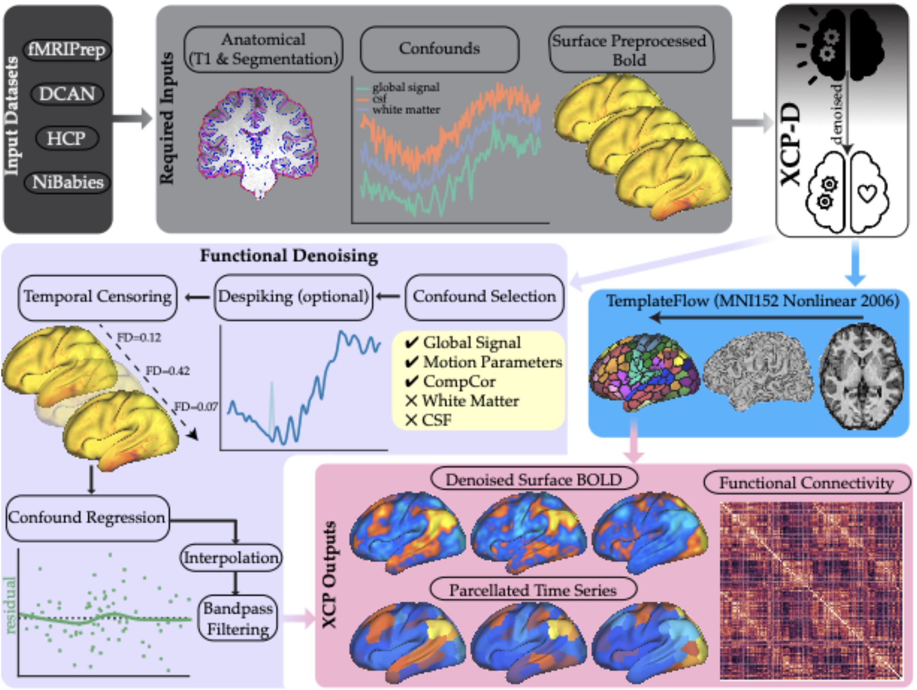
fMRIPrep
NiChart is funded by a U24 Grant from the Brain Initiative / NIH
pNet
XCP
Notes:
NiChart supports processing of diverse neuroimaging data types including MRI, fMRI, and DTI. It is underpinned by the large ISTAGING Dataset, comprising over 70,000 multi-modal MRI time points from 23 studies, facilitating a robust analysis framework.
The initiative is funded by a U24 Grant from the Brain Initiative/NIH ****** FILL THIS INFO HERE ******
As NiChart evolves, mature research prototypes are slated to be integrated, enhancing its analytical repertoire. Current NiChart pipelines include DLICV for deep learning-based skull stripping and DLMUSE for segmentation into anatomically specific ROIs.
Kaapana leverages these pipelines—DLICV and DLMUSE—as its computational backbone, utilizing Docker containers for efficient, scalable deployment. NiChart's flexibility is exemplified by its accessibility via command-line interfaces, web applications, and containerized solutions, ensuring broad usability across different computational environments.

Slide 5



You can find more info on NiChart:
https://github.com/CBICA/NiChart_Project
@NiChart_AIBIL

